Slide 1

Bank Auction
Our Team
Manish Shaw - 15/CA/601
Rajan Priyadarshi – 15/CA/629
Nabanita Mondal – 15/CA/634

Slide 2
Requirements
A laptop
XAMPP Server Software
www.w3schools.com for knowledge of CSS, HTML, Javascript, etc.
www.stackoverflow.com for solving the errors we faced.
Google Images – for pictures

Slide 3
Purpose
The purpose of this mini-project is to develop a valuable set of information sources that provide banks to auction properties electronically.
This website will also serve as a e-Auction platform where can put their properties on sale and buyers will place a bid.

Slide 4


Target Audience
Bank
Buyer

Slide 5
Objectives
Easy site creation facility
- Users with no programming knowledge
User Friendly Interface and User Data Management
Centralized Updation
Portability
- Powerful & flexible web page design
- Makes complex things simple

Slide 6
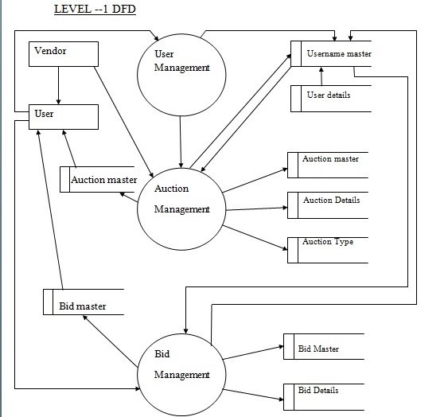
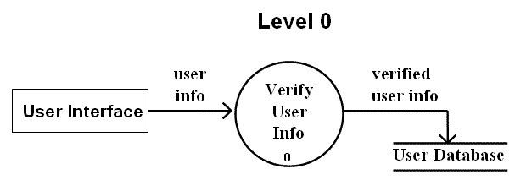
DFD

Slide 7
GUI of our website

Slide 8
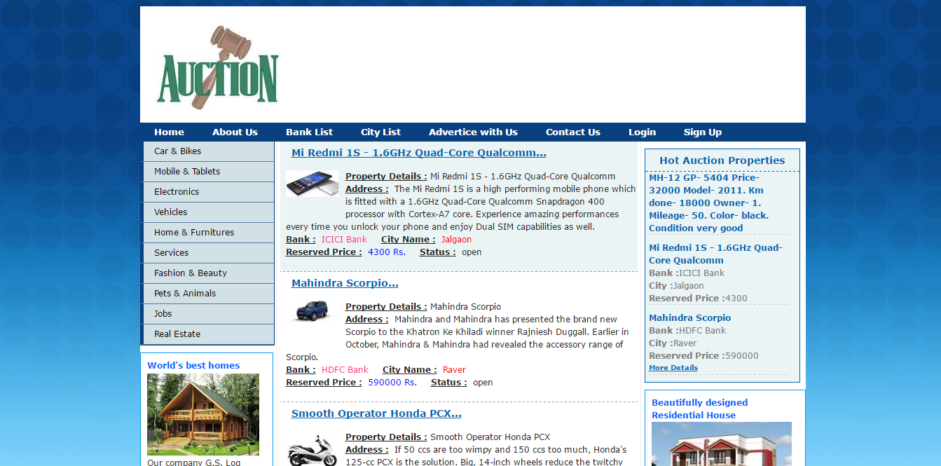
Home Page

Slide 9
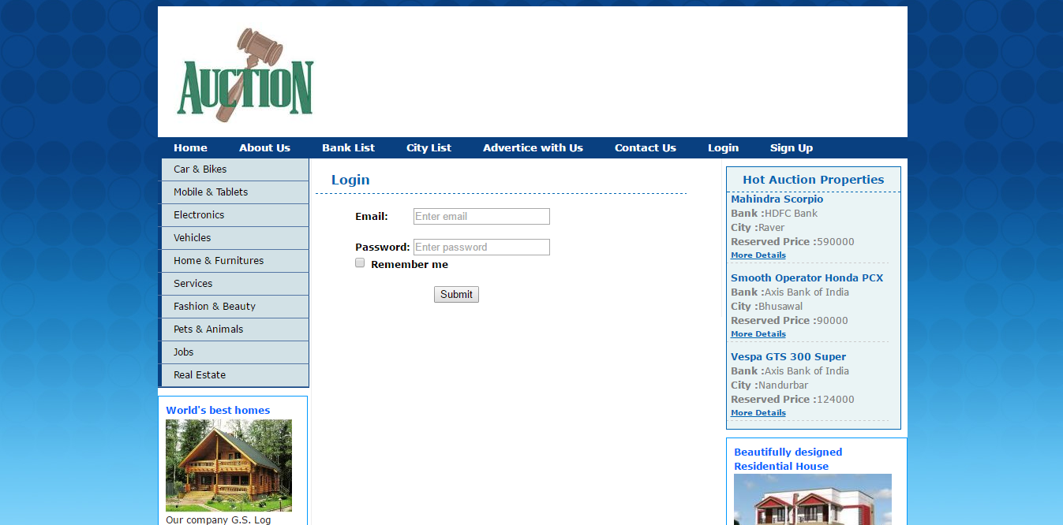
Login Page

Slide 10
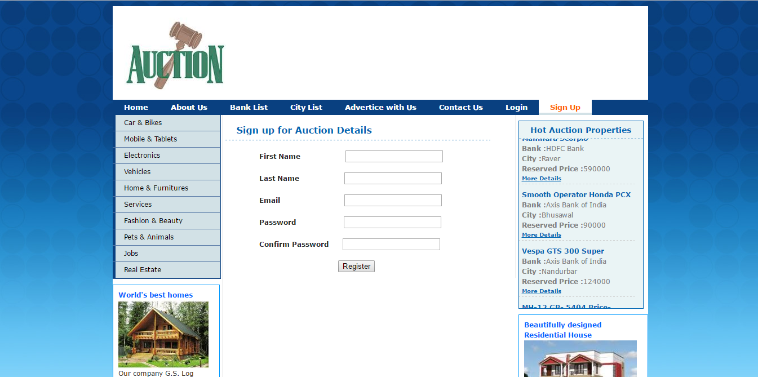
Sign Up Page

Slide 11
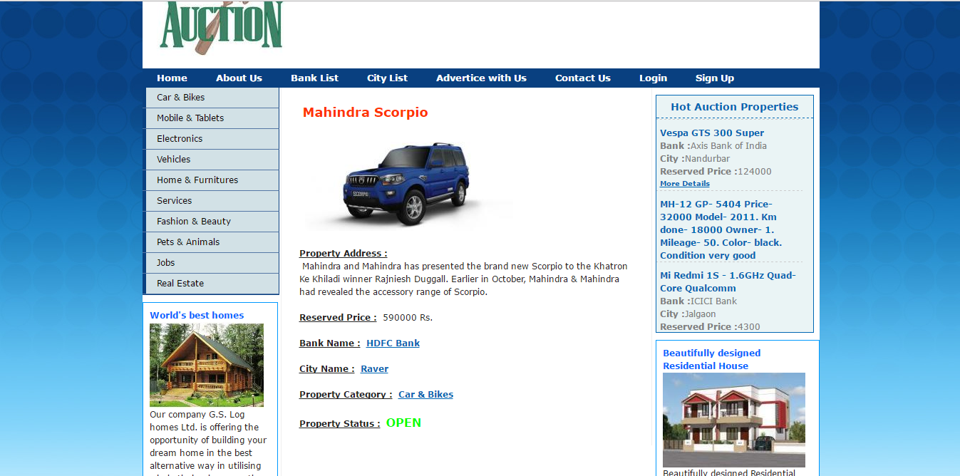
Product Description

Slide 12
Future Enhancements
Debugging
More User Friendly
Memory and Traffic Management
Live Bidding
More Secure

Slide 13
Thank You

